Slide 1
Risk Analysis
Analyze the risk in relation to bus factor of a GitHub Project
Noul Singla

Slide 2
Bus Factor
Minimum number of people who are needed to keep a project running.

Slide 3
Importance
Low bus factor means :-
Higher dependency
Higher risk associated with each member of project
Higher Constraint on progress and development
Limited resources available
Limited Scope
This is not specific to just GitHub project but even for organizations. Ex. Quadriga CX
Notes:
The online startup can’t retrieve about C$190 million ($145 million) in Bitcoin, Litecoin, Ether and other digital tokens held for its customers, according to court documents filed Jan. 31 in Halifax, Nova Scotia. Nor can Vancouver-based Quadriga CX pay the C$70 million in cash they’re owed.

Slide 4
Risk Analysis
Low bus factor is surely a considerable factor of risk, but is it enough?

Slide 5
Risk Analysis
Low bus factor is surely a considerable factor of risk, but is it enough?
This project aims to analyze and provide answer to the following:-
Is bus factor enough to define the quantitative risk?
How much of it is a risk on GitHub projects?
Does low bus factor often lead in closure.
Does it change (increase, decrease) with time.
Does the non – major contributor cover up if needed.
Does the major contributor change over time.

Slide 6








Data Pipeline
API
Import RDBMS
Process log
csv
Clone
Analysis
and
Visualization

Slide 7
Technology Stack
Shell Script
Java
MS SQL Server
R

Slide 8
Data Downloading
API
Get the names of highest starred projects
Skip the first few hundreds
Clone
Space constraint could only clone ~9500 projects

Slide 9
Generating Logs
Commit logs
Used a batch file to generate commits
Reformat data
Each commit has multiple files and some unwanted merge commit.
Used a java program to make it a table loadable file.

Slide 10
Cleaning Data
Raw
9500 project
Cleaned
M,A,D operations only and 97 file type
8800 projects
Filtered
2015-2018 with at least 1 author
800 Million Commit
780 million commit
250 million commits
7900 projects
Commits have comma separated author - skipped
Some author name have comma - cleaned
Operations M,A,D considered – Rest cleaned
Not all projects have authors – skipped
Data for 10+ years, considered 4 years
There are 30k+ file types
File type >0.8% considered
109 file types
97 considered after filtering

Slide 11
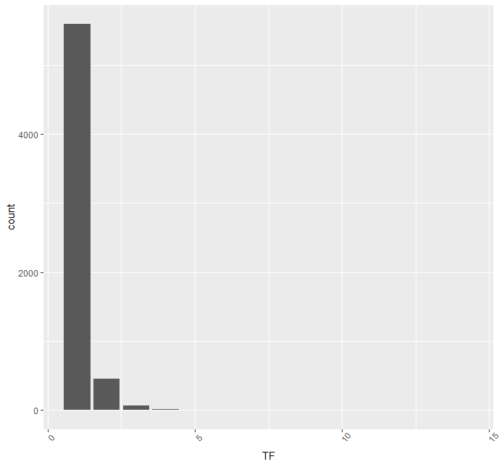
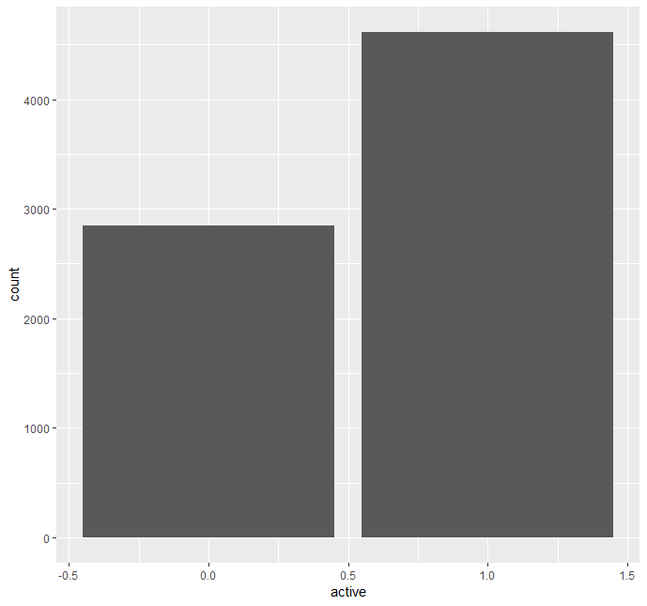
Risk Analysis
Does low bus factor often lead in closure. NO
Bus Factor distribution in 2015
Project active distribution in 2018

Slide 12
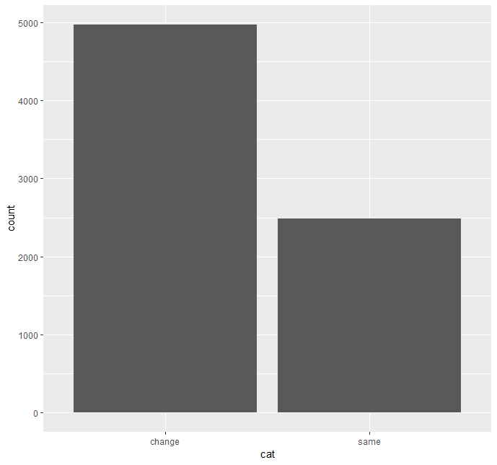
Risk Analysis
Does it change (increase, decrease) with time. YES
Majority cases have change over time
There is no strict increase or decrease pattern but a handful of cases.

Slide 13
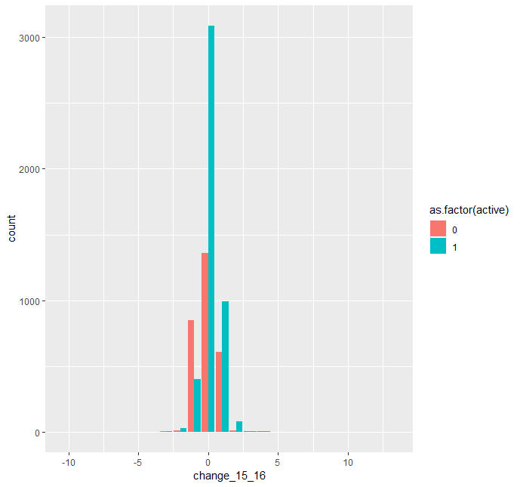
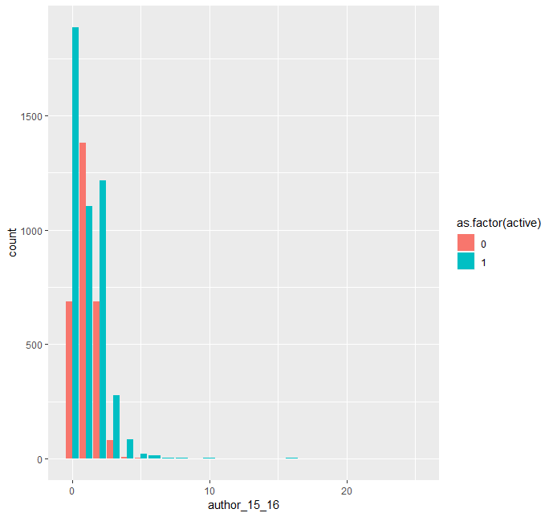
Risk Analysis
Does the non – major contributor cover up if needed. SOMETIMES
Does the major contributor change over time. YES

Slide 14
Methodology for Feature Generation
1. Calculate bus factor on yearly basis. ( considering 4 years for now)
2. Generate new features to analyze the risk:-
Relative Change in bus factor year2 – year1
Relative Change in bus factor year3 – year1
Relative Change in bus factor year3 – year2
Change in user contributor to bus factor year2 – year1 : absolute change in authors
Change in user contributor to bus factor year3 – year1 : absolute change in authors
Change in user contributor to bus factor year3 – year2 : absolute change in authors
Is the project starter still part of the project.
If project was active in 2015 : binary
If project was active in 2016 but not in 2015 : binary
If a project Bus factor changed over the year or not : Change if it changed, same if it remain same.
3. Observe changes to these factors to see if lower bus factor remain a high risk.

Slide 15
Modified Bus Factor
In this analysis, DOA calculation was modified in the following ways: -
FA or First authorship was defined as the author info in the first commit starting from 1-1-2015. Any ownership changes before 2015 were ignored.
DOA was changed to DOA/Year and the factors DL and AC were now year dependent.
DL was now number of changes made by a user in a particular year and AC was modified to include all the commits made in a particular year.
The weights were kept the same on the assumption that this is what DOA will be if project started and ended in same year.
Normalizing the DOA and cutoff for DOA was kept the same.
DOA/year = 3.293 + 1.098 ∗ FA + 0.164 ∗ DL/Year − 0.321 ∗ ln(1 + AC*/Year )

Slide 16
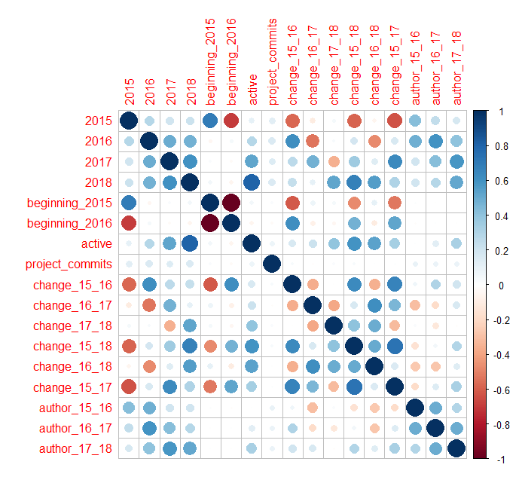
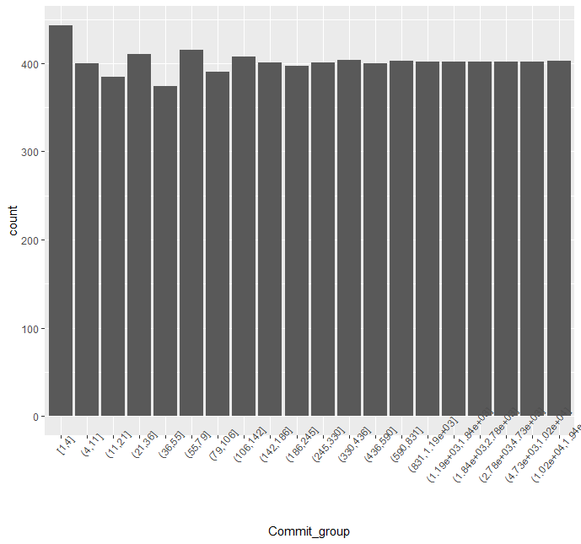
Exploration of features

Slide 17
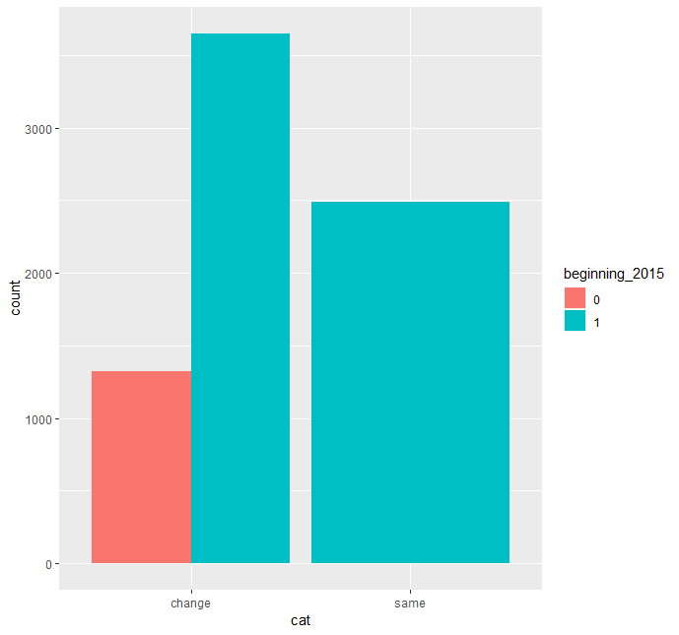
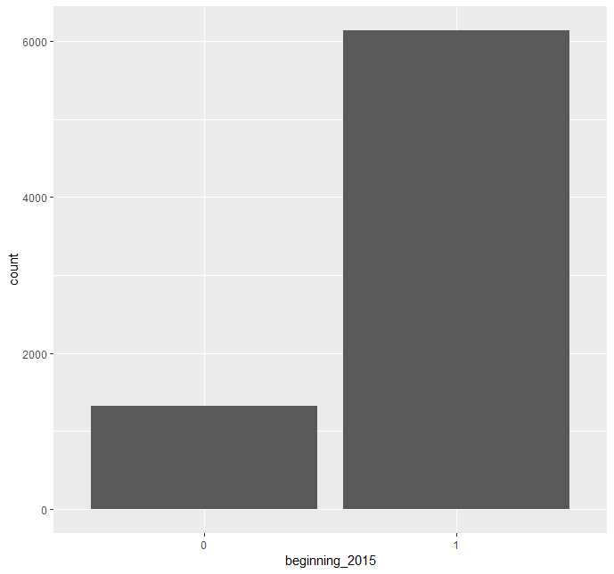
Exploration of features

Slide 18
Approach
Instead of new statistical metric as earlier planned, a response was generated if project is active or dead in 2018 and supervised machine Learning Models were implemented.
Logistic Regression
Decision Tree
Random Forest
Adaptive Boosting

Slide 19
Analyzing Output
ACCURACY | Train | Test
Regression{1} | 81.11 | 81.65
Random Forest | 82.21 | 82.04
Adaptive Boosting | 82.6 | 82.45
Decision Tree | 82.4 | 82.11
Regression{2} | 80.6 | 81.25
Regression 1 is with all parameters and Regression 2 is with only the 3 bus factors.

Slide 20
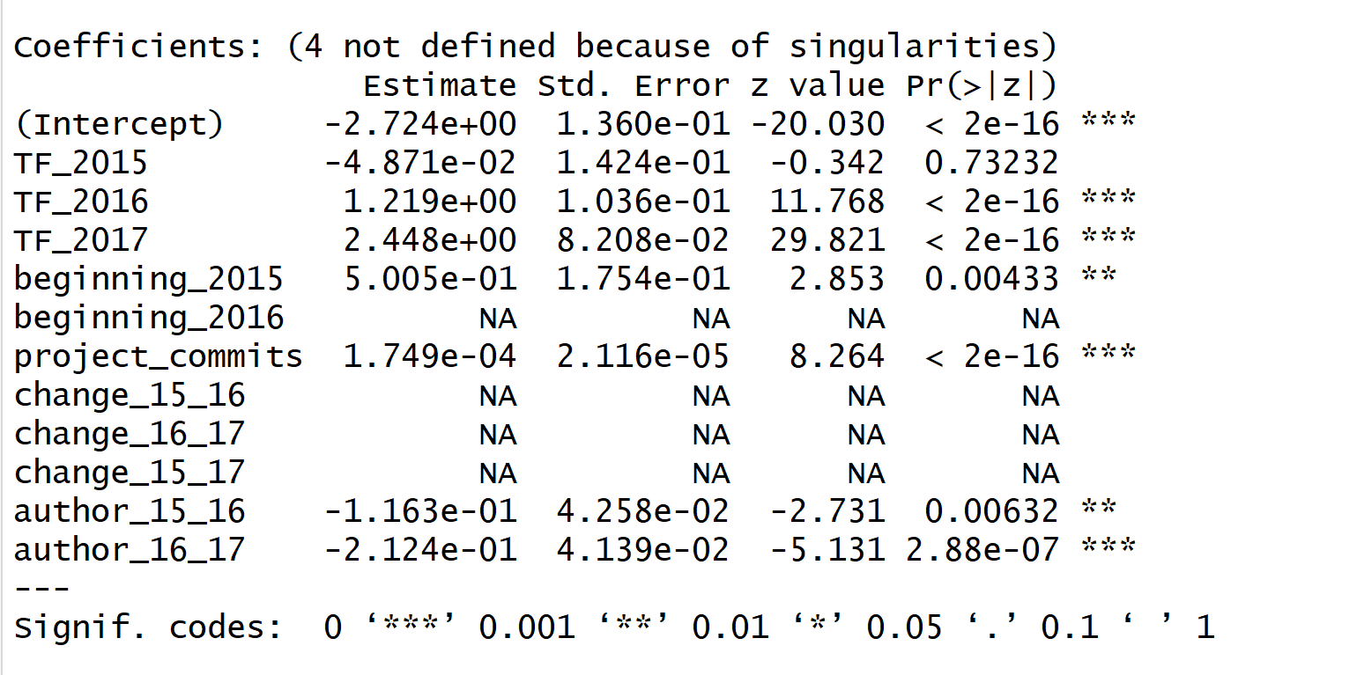
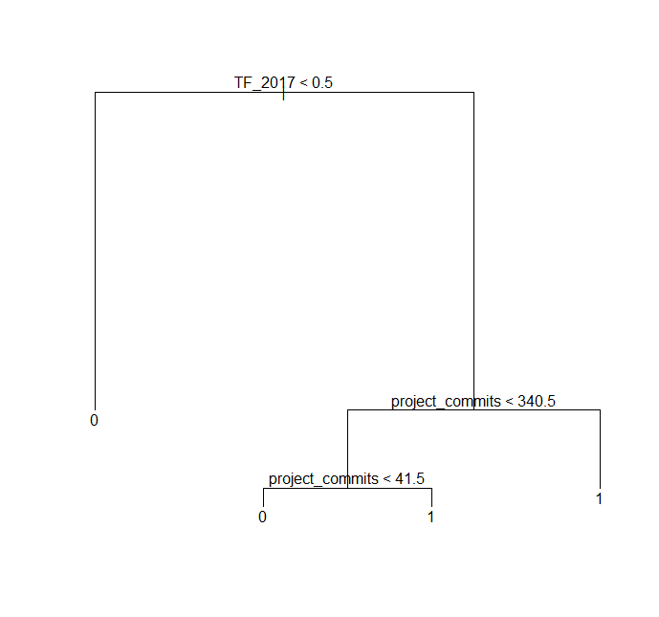
Analyzing Output

Slide 21
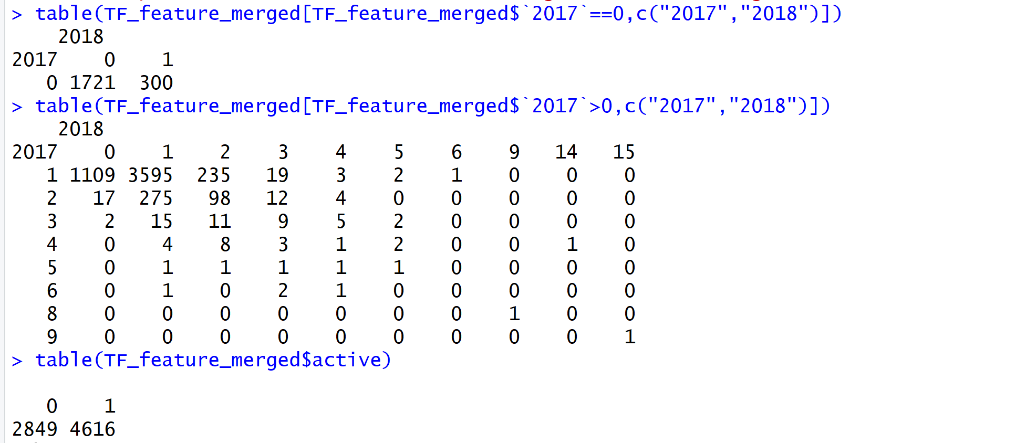
Verifying Result

Slide 22
Conclusion
Bus Factor are good measure of risk.
The modified Bus factor/year is a better factor to consider.
Total commits play an important role in predicting a closure.
Change in author or change in bus factor do not have enough variance to help increase the prediction accuracy.
Models did similar on train and test and have significant improvement from 62% naïve solution.

Slide 23
THANK YOU

